Slide 1

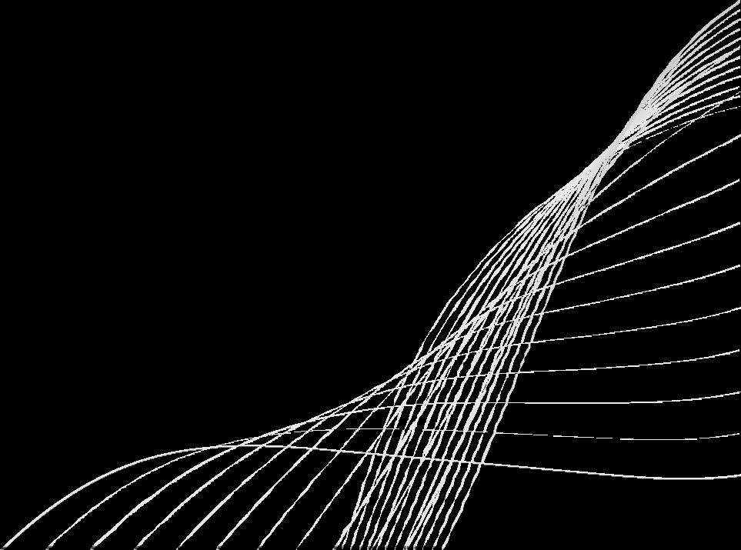
SRINIVAS UNIVERSITY INSTITUTE OF ENGINEERING & TECHNOLOGY
SUPPLY CHAIN DATA ANALYSIS
By : YALLAMMA.B(01SU22AI081)
DEPT OF AI & ML

Slide 2
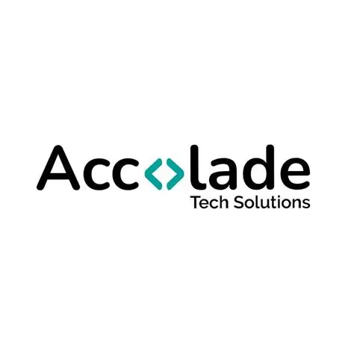

COMPANY PROFILE
Accolade Tech solution is a technology-based company located in Mangalore.It focuses on IT services,data analytics,and software solutions.The Company provides real-time industry projects and training for students.It aims to deliver efficient and data-driven solution to businesses.

Slide 3
INTERNSHIP DETAILS
Duration: 2 Months
Department:Data Analytics
Role:Data Analytics Intern
Domain:Data Analytics
Used data to identity patterns,trends,and inefficiencies
Worked on real-time datasets and analytical tools

Slide 4
TRAINING OBJECTIVES
To understand real-world data analysis process
To learn data cleaning and preprocessing
To gain knowledge of analytical tools
To develop problem-solving and decision-making skills

Slide 5
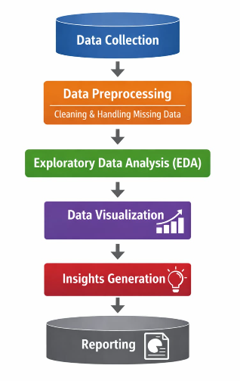
METHODOLOGIES USED
Data Collection
Data Preprocessing
Exploratory Data Analysis
Data Visualization
Insights Generation

Slide 6
TOOLS USED
Python - Core language for cleaning, analyzing, and visualizing data.
Pycharm -Used as an IDE to develop and run python programs.
• Pandas - For data loading, exploration, and manipulation.
• NumPy - For numerical operations and efficient array handling.
• Matplotlib - For plotting basic graphs and visualizations.
• Streamlit- Used to build an interactive web application for data analytics

Slide 7























PROJECT UNDERTAKEN
Project Title-Supply Chain Data Analytics
Aim-To analyze supply chain performance and improve efficiency
Worked on datasets related to inventory,demand,and delivery.

Slide 8
WORK PROCESS/IMPLEMENTATION
Data collection from datasets
Data Cleaning (handling missing values,errors)
Data Analysis using Python
Visualization using graghs and charts
Interpretation of results
07

Slide 9
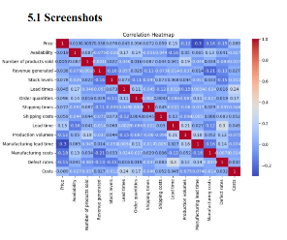
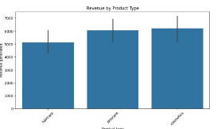
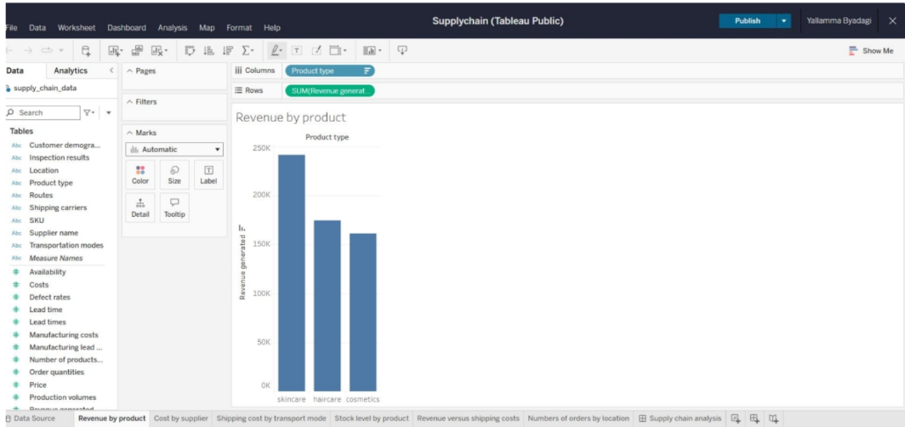
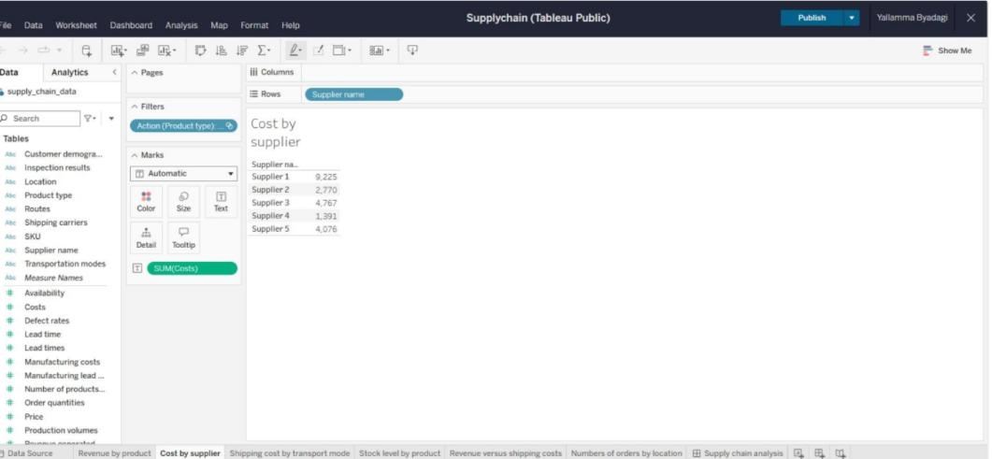
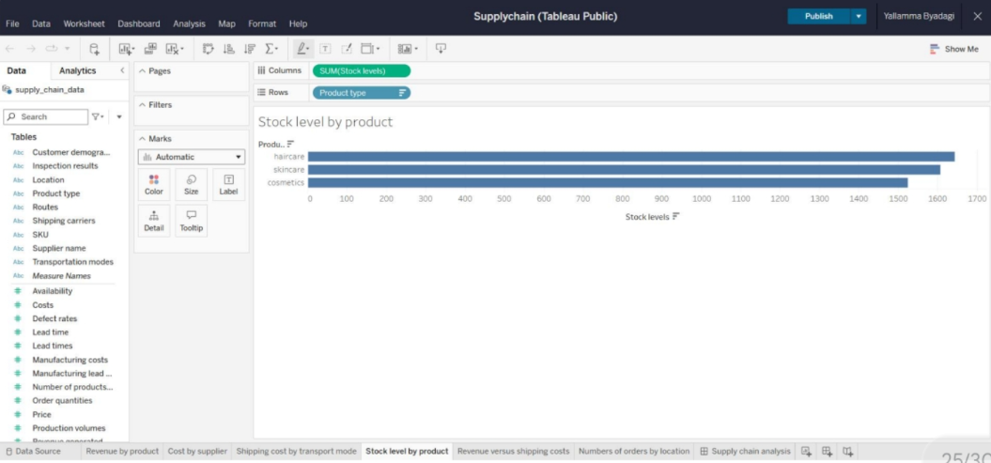
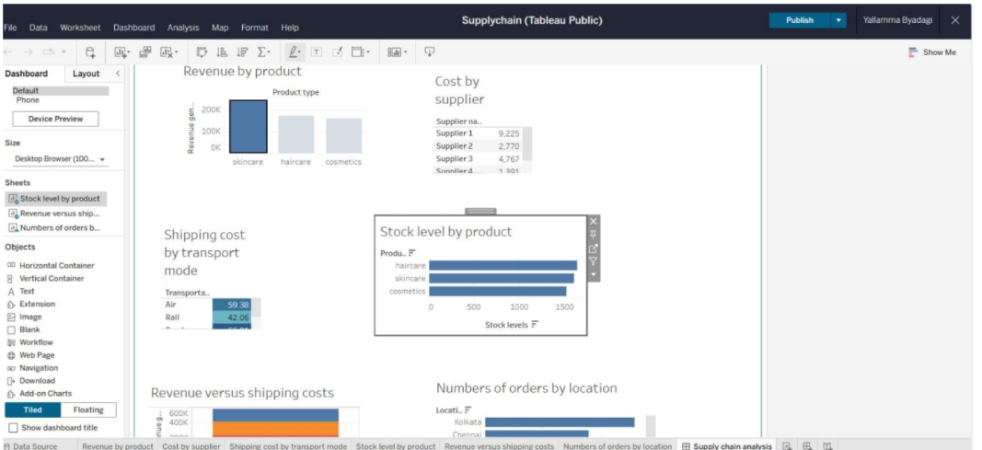
RESULT
l

Slide 10
CONCLUSION
“In this internship, I learned how to clean and analyze Supply chain data analysis using Python and Streamlit. Gained practical knowledge in data analytics This helped me improve my technical and problem-solving skills. Overall, it was a good practical experience that connected my learning with real-world applications.”
09

Slide 11
THANK YOU
10

